Slide 1

2012 Beta Seminar
694 Software Engineering

Slide 2
Overview
WPILib
Command-based programming
NetworkTables
SmartDashboard
Preferences
Laptop-based vision processing
Jaguar firmware update
Automatic Ramp mode
David dual relay module
4-slot cRIO-FRC II
Kinect

Slide 3
Command-based Programming
Subsystems
Define the capabilities of each part of the robot
Subclasses of Subsystem
Commands
Define the operation of the robot incorporating the capabilities defined in the subsystems
Commands are subclasses of Command or CommandGroup

Slide 4
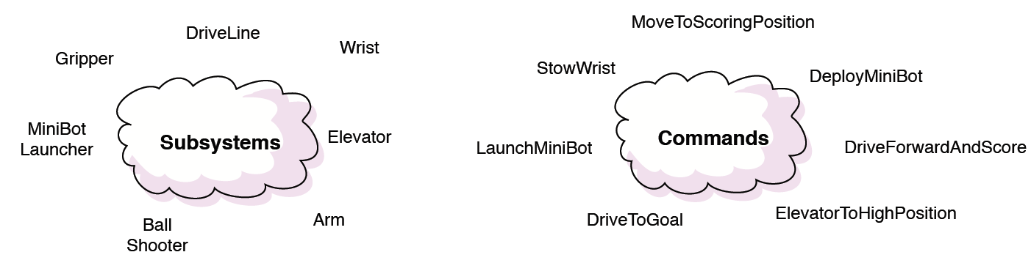
Subsystems and Commands

Slide 5
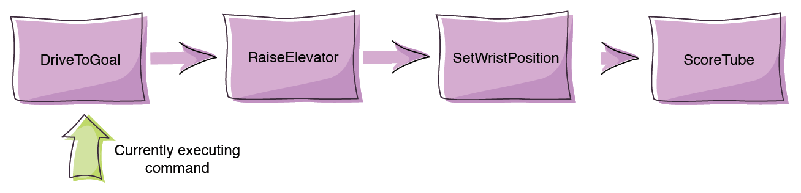
CommandGroup

Slide 6
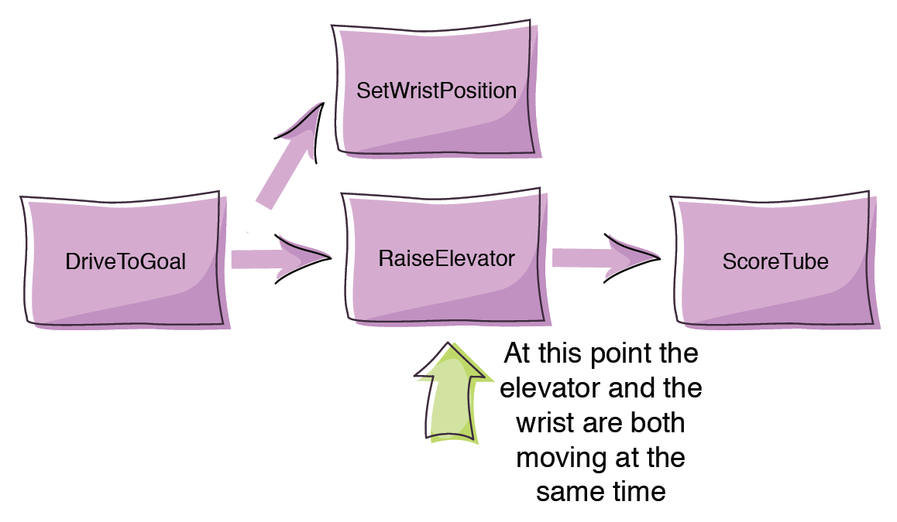
CommandGroup

Slide 7
NetworkTables
Allow the programmer to easily send data between a laptop (either the driver station laptop or another laptop) and the robot
Applications
SmartDashboard
Preferences
Laptop-based vision processing

Slide 8
NetworkTables – Data Transfer
Bidirectional
Robot can send data to a laptop
Laptop can send data to robot
Named
Key-value pairs
Full notification
No need to poll for new values
NetworkListener interface

Slide 9
NetworkTables – Data Transfer
Multiple named tables
e.g. SmartDashboard, Preferences
Transactional model
Ensures that a group of values are updated simultaneously

Slide 10
Preferences
Robot can save data such as constants in flash memory
Data can be accessed and modified using NetworkTable
Testing: IOException when trying to save

Slide 11
Laptop-based Vision Processing
Vision processing requires heavy computation
Camera images can be processed on a laptop instead of on the cRIO
NI Vision Library
FIRST-provided Java wrapper for OpenCV (Open Source Computer Vision) library
Documentation?
Data can then be sent back to robot using NetworkTable

Slide 12
Jaguar - Firmware Update
Automatic Ramp mode
694’s troubled relationship with Jaguars
New Jaguar mode that, when activated, automatically ramps the output voltage to the motor at a preset ramp rate
Can be accessed regardless of the control mode; Servo PWM, CAN, or Serial
One-second fan test

Slide 13
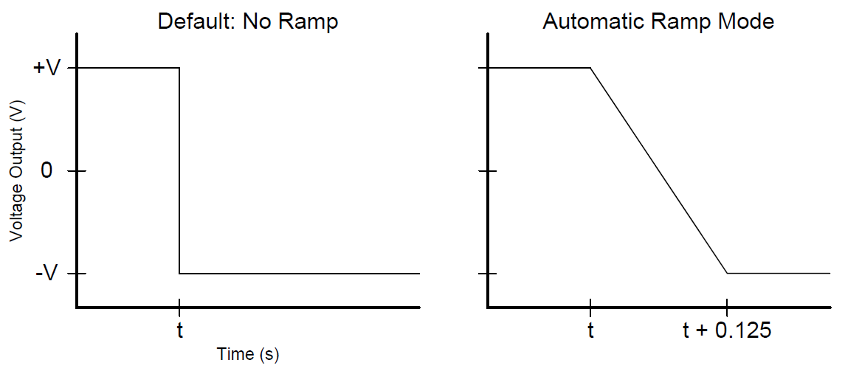
Ramp Mode - Graph

Slide 14
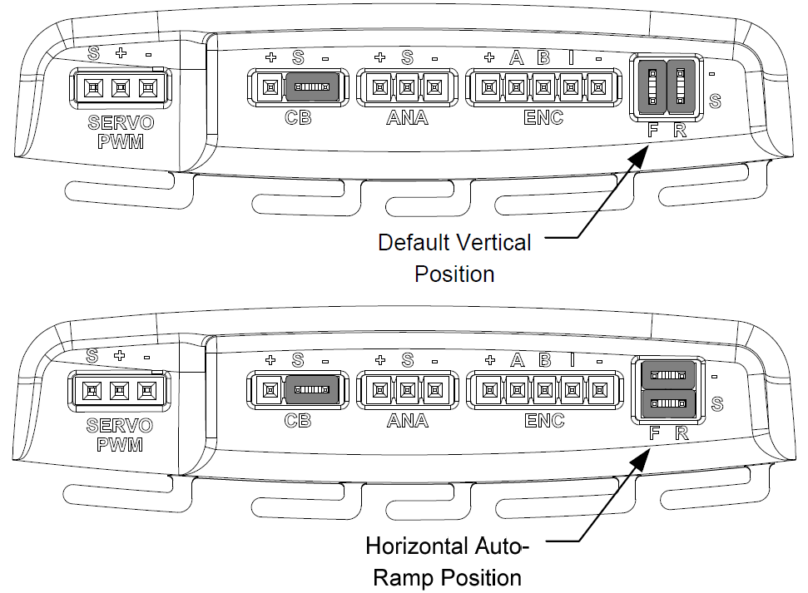
Ramp Mode - Jumpers

Slide 15
Ramp Mode - Testing
Placed Mecanum drive robot on blocks
Set two Jaguars to normal mode and two to Automatic Ramp mode
Rapidly switched between full forward and full reverse using “button drive”
Two Jaguars failed; one on normal mode, and one on Automatic Ramp mode
Became unresponsive, indicator LED not on
Jaguars operational after robot reboot

Slide 16
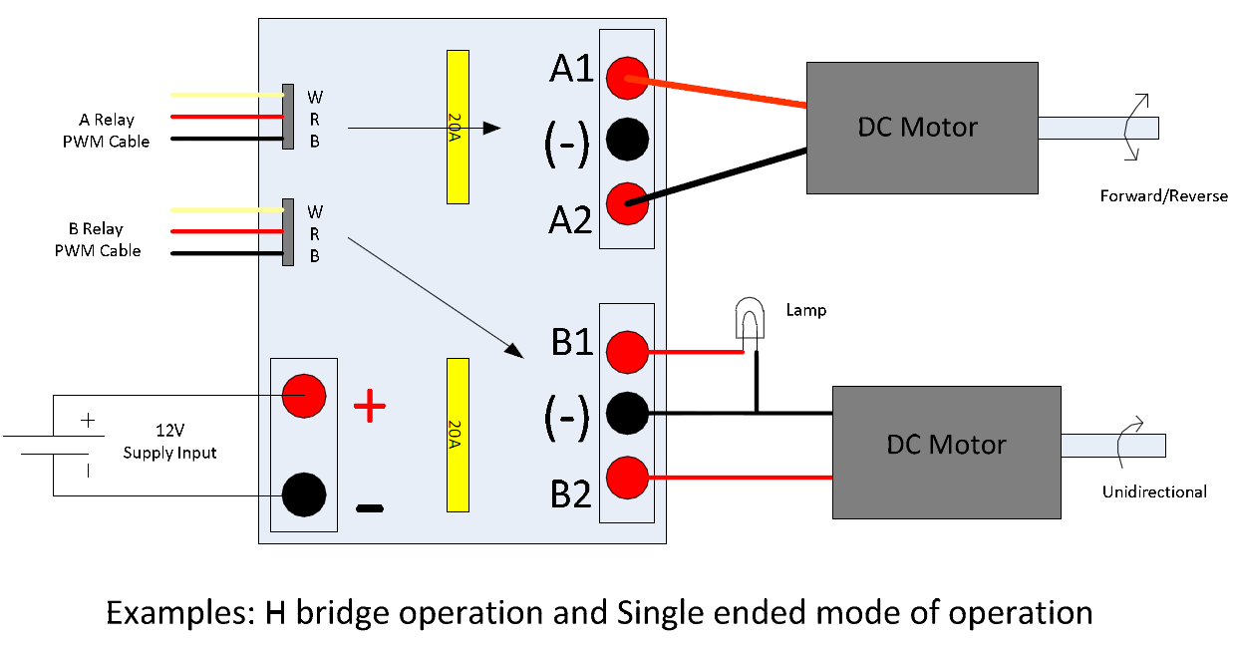
David Dual Relay Module
Will not be available in 2012
Equivalent to two Spikes

Slide 17
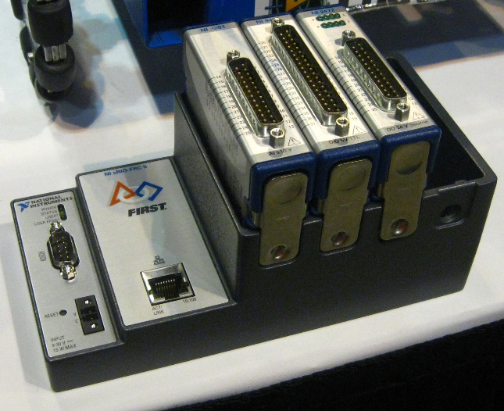
4-slot cRIO-FRC II
team358.org

Slide 18
4-slot cRIO-FRC II — comparison
Single ethernet port
7” long (~2/3 the length)
30% lighter
256MB RAM (2x the old cRIO)
512MB storage (2x the old cRIO)

Slide 19
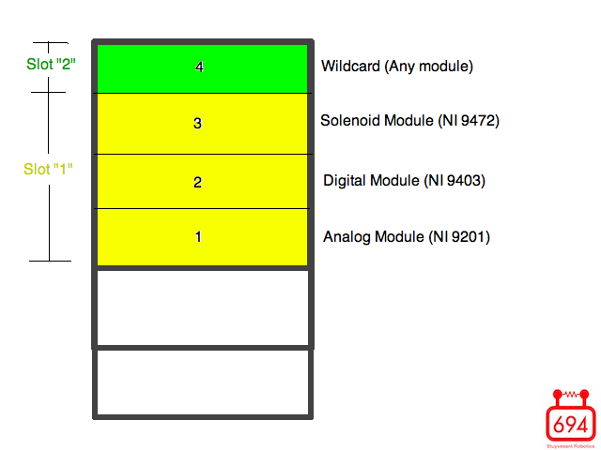
Slot configuration (4-slot)
Slot “2”
Slot “1”

Slide 20
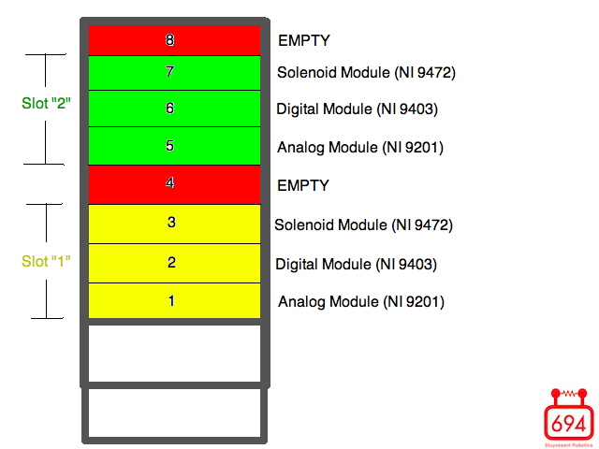
Slot configuration (8-slot)
Slot “2”
Slot “1”

Slide 21
How it works
cRIO determines the physical location of modules from code based on predetermined module order

Slide 22
How it works
cRIO determines the physical location of modules from code based on predetermined module order
A Digital Module in slot “1” in code must be in physical cRIO slot 2

Slide 23
How it works
cRIO determines the physical location of modules from code based on predetermined module order
A Digital Module in slot “1” in code must be in physical cRIO slot 2
A Digital Module in slot “2” in code must be in physical cRIO slot 4 on the 4-slot, and slot 5 on the 8-slot

Slide 24
Huh?
Victor left_motor= new Victor(1, 5);
Victor in 5th channel of Digital “1^{st”} slot
Physical Digital I/O slot #2 on both old & new cRIOs

Slide 25
Huh?
Victor left_motor= new Victor(1, 5);
Victor in 5th channel of Digital “1^{st”} slot
Physical Digital I/O slot #2 on both old & new cRIOs
Victor left_motor= new Victor(5);
Same as above

Slide 26
Huh?
Victor left_motor= new Victor(1, 5);
Victor in 5th channel of Digital “1^{st”} slot
Physical Digital I/O slot #2 on both old & new cRIOs
Victor left_motor= new Victor(5);
Same as above
Victor right_arm= new Victor(2,5);
Victor in 5th channel of Digital “2nd” slot
Physical Wildcard slot #4 on new cRIO
Physical Digital I/O slot #6 on old cRIO

Slide 27
Okay…
Gyro gyro = new Gyro(2, 1);

Slide 28
Okay…
Gyro gyro = new Gyro(2, 1);
Constructs a Gyro object in the 1st channel of the Analog “2^{nd”} slot

Slide 29
Okay…
Gyro gyro = new Gyro(2, 1);
Constructs a Gyro object in the 1st channel of the Analog “2^{nd”} slot
Corresponds to physical 4th “wildcard” slot on new cRIO

Slide 30
Okay…
Gyro gyro = new Gyro(2, 1);
Constructs a Gyro object in the 1st channel of the Analog “2^{nd”} slot
Corresponds to physical 4th “wildcard” slot on new cRIO
Corresponds to physical 5th Analog I/O slot on old cRIO

Slide 31
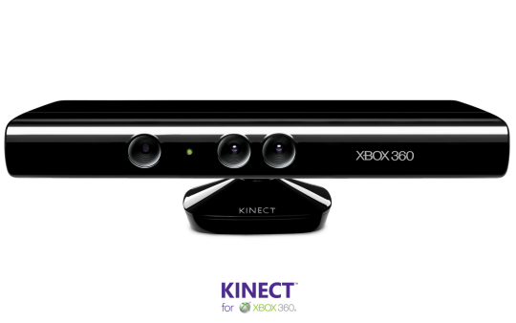
Kinect

Slide 32
Kinect
You are the joystick
Arms – “forwards” and “backwards”
Head, legs – “buttons”
Left Arm → left joystick
Right Arm → right joystick
Head/legs can be programmed to do anything

Slide 33
Kinect
KinectStick left = new KinectStick(1);
KinectStick right = new KinectStick(2);
…
drivetrain.tankDrive(left, right);

Slide 34
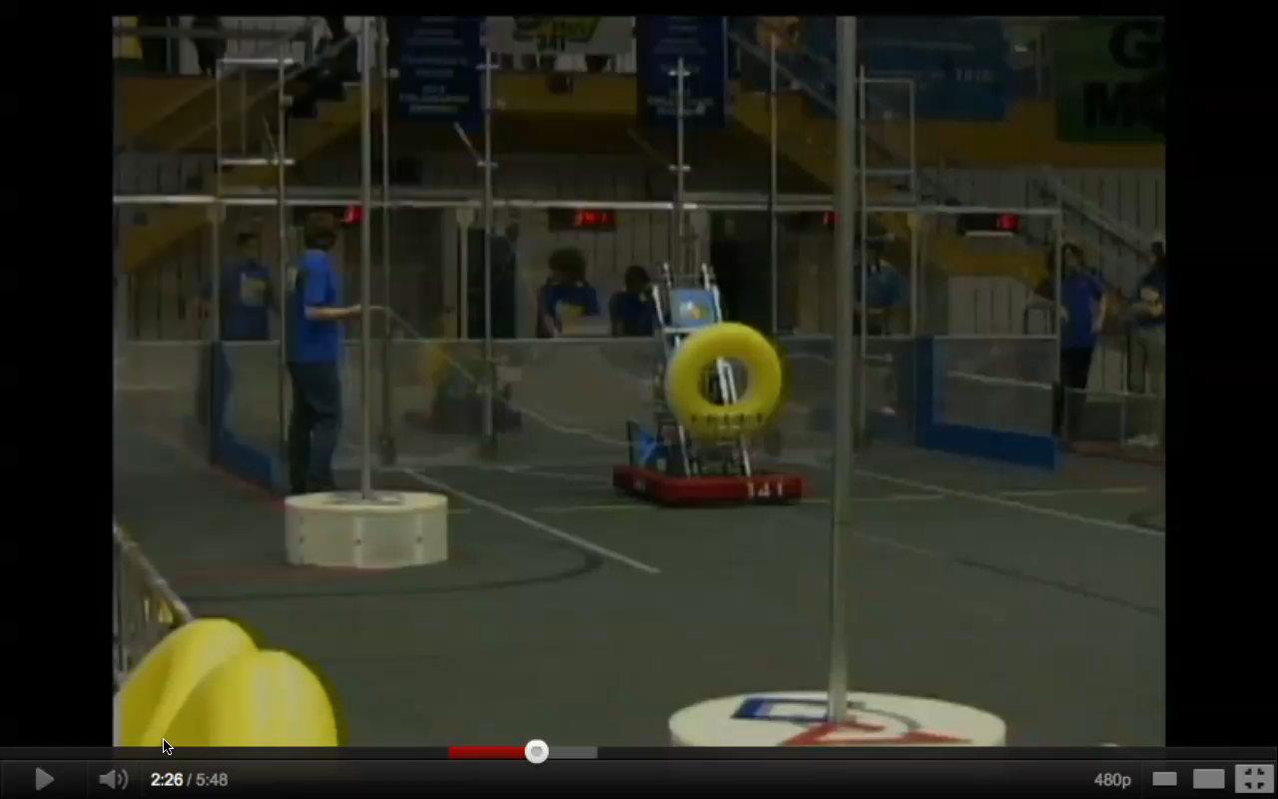
Kinect

Slide 35

Thanks!
www.github.com/prog694
www.stuypulse.com

